Slide 1
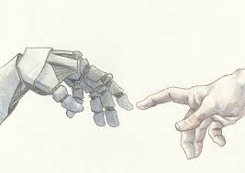
Artificial Intelligence vis-à-vis Role of Company Secretary
Kiran M. Chitale
B.Com., LLB., FCS
Disclaimers:
Source for images : www.google.co.in. All IPR is owned by respective owner.
This presentation includes personal views of the author

Slide 3
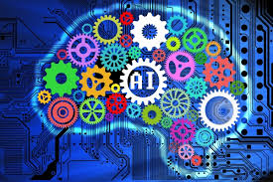
What is Artificial Intelligence ?
Theory and Development of computer systems
System is able to perform tasks normally requiring human intelligence¹
Examples: visual perception, speech recognition, decision-making, and translation between languages¹.
¹ Online Oxford Dictionaries (https://en.oxforddictionaries.com/definition/artificial_intelligence)
In simple terms it is a computer program designed to perform designated tasks to replace human intervention to some extent.

Slide 4
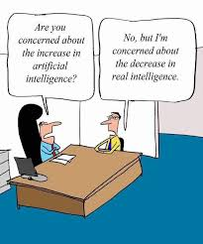
Q. : Are you concerned about increase in AI ?
Ans : No, I’m concerned about decrease in real intelligence

Slide 5
Where are we today ?
Are majority tasks of a Company Secretary carried through deployment of Artificial Intelligence (“AI”) ?
Why ?
Does the technology exist?
Do we have domain experts?
Do we have enough skills and funding to use AI more and more?
Largely speaking, there is no drive for shifting suitable work carried out by Company Secretaries to Artificial Intelligence

Slide 6
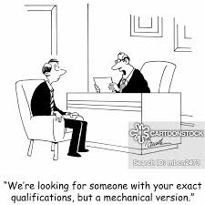
We are looking for someone with your exact qualifications, but a mechanical version

Slide 7
Where would we want to be ?
Through use of AI, a Company Secretary (“CS”) should be freed up from most of his routine/ recurring/ usual tasks
Technology should assist a CS to perform such tasks or action at fast speed and with accuracy
Contribute more towards actions that require human intelligence/ actions and behaviours that cannot be performed by machines
There is definitely great value attached to use of AI – which needs focus and investment

Slide 8
Robot : I wonder whose job I will take first
You could never do my job
You are not doing anything.
Let that sink in

Slide 9
Some more examples
Amazon Alexa
Google Home
Apple Siri
A video game where computer acts as another player/ opponent

Slide 10
Pros - Cons
Sr. | Pros | Cons
1 | Technical upgrade | Cost/ Funding
2 | Work with fast pace and more accuracy | Expectations of response go up/ Pre-supposes use of technology by all
3 | Routine tasks taken care by machine/ computer program | Possibly no more jobs for basic areas of tasks that get automated
4 | Less paper work/ Simplification | ---
5 | Time availability for strategic/ more important work | ---
6 | Data analytics/ Automation in legal research/ in governance/ reminders for compliances | (Increased responsibility to apply/ make use of such data for enhancing governance)
7 | Less time/ energy spent for administrative tasks/ paper work | Machine cannot act beyond the program coded walls
8 | New job opportunities | (Learning technology tools)
9 | Key updates/ actions for clients | ---

Slide 11
Sr. | Actions converted to AI | Actions NOT converted to AI
1 | Drafting of resolutions | Writing detailed minutes based on discussion in the meeting
2 | Record keeping based on data input available in electronic format | Review/ Audit/ Confirmation/ Validation of records
3 | Drafting of standard letters to Stock Exchanges/ SEBI, etc. | Review and timeliness of response to ensure compliance
4 | Filling up of forms based on inputs available to the system | Review/ Validation/ Authentication/ Timeliness of reporting/ filing
This is illustrative; need to expand to other areas of work for a CS. We need to have attitude that would drive us to go digital.

Slide 12
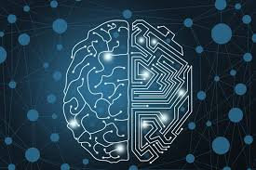
Human intervention to stay

Slide 13
CS to continue adding value
Advisory services
Use of data analysis for better governance
Representing before authorities
Certification and audit
Completing compliance through digitization
Interpretation of law
Stakeholder engagement/ management
Other services e.g. Valuer, Arbitrator, etc.

Slide 14
Humble Suggestions
To deliberate areas of work that can be deployed through use of AI/ machine learning/ digital, etc.
To engage with start-ups to build applications suitable for Company Secretaries
To have execution focus and focus on quick action to have small wins/ low hanging fruits

Slide 15
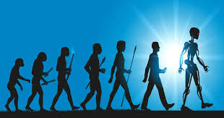
Artificial intelligence cannot match professionalism, experience, judgement, knowhow and skills
On a lighter note: Artificial intelligence cannot match natural stupidity either ☺☺☺

Slide 16
Volvo Car – Takes Interview

Slide 17
Thank you

